Slide 1
Stress, Lifestyle, and Health
Chapter 14

Slide 2
Agenda
What is Stress?
The Stress Response
Stress and Illness
Regulation of Stress
Positive Psychology

Slide 3

What do you think a stressor is?

Slide 4
What are some examples of each of these stressors?
Traumatic events
Life changes
Daily hassles
Occupation-related stressors

Slide 5
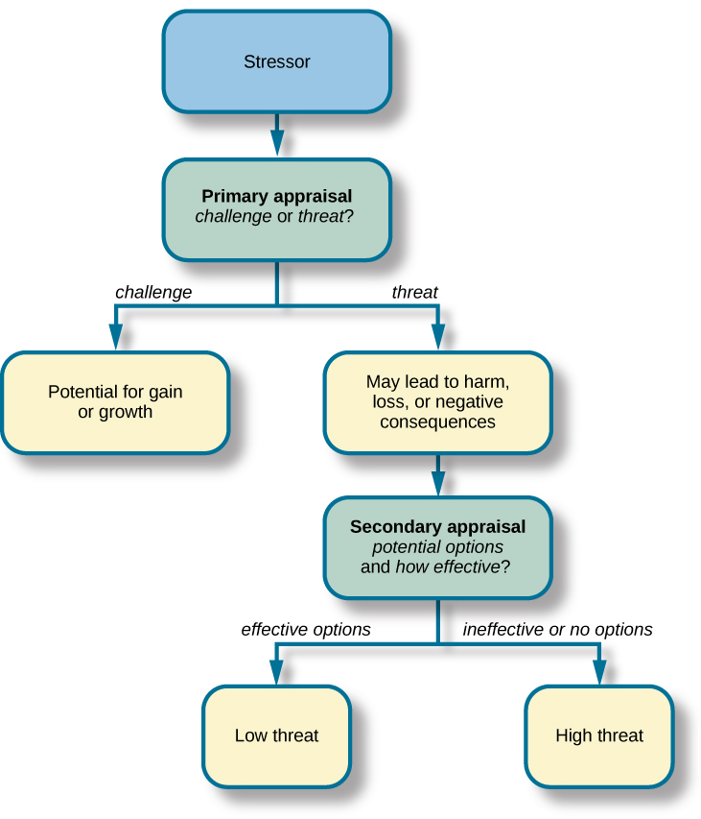
Appraising a Threat

Slide 6
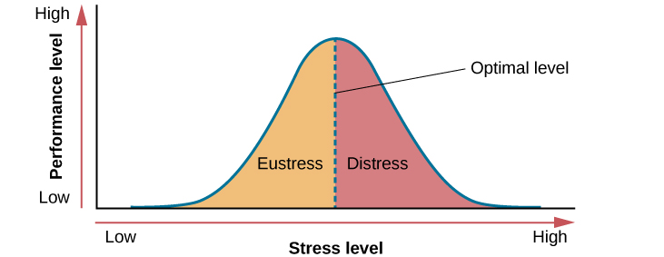
Good and Bad Stress

Slide 7
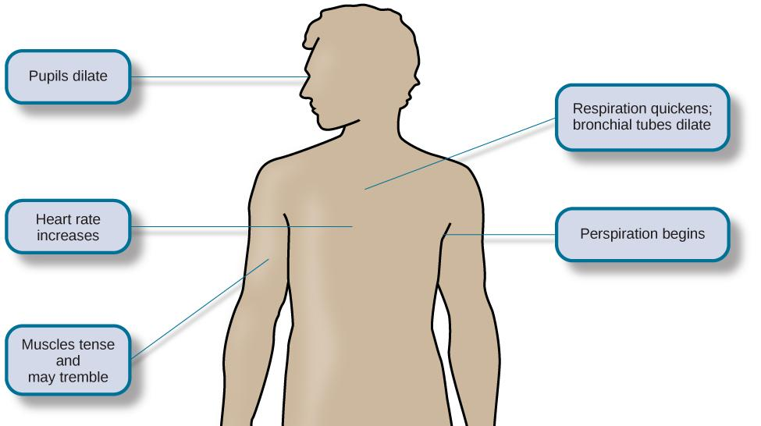
Fight or Flight Response

Slide 8
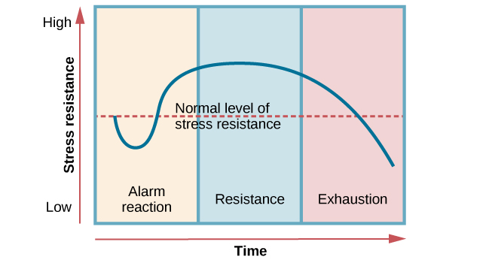
Selye & The General Adaption Syndrome

Slide 9
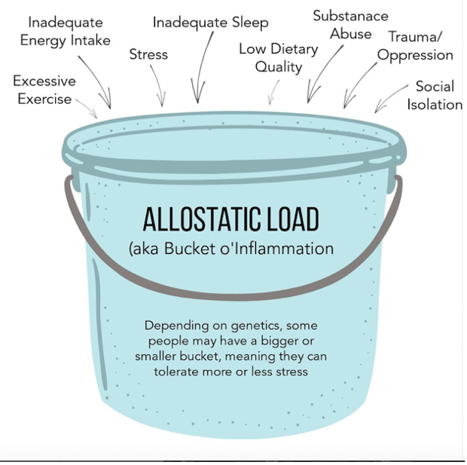
How much stress is too much?
It depends on your capacity to carry stress

Slide 10
The STRESS RESPONSE

Slide 11
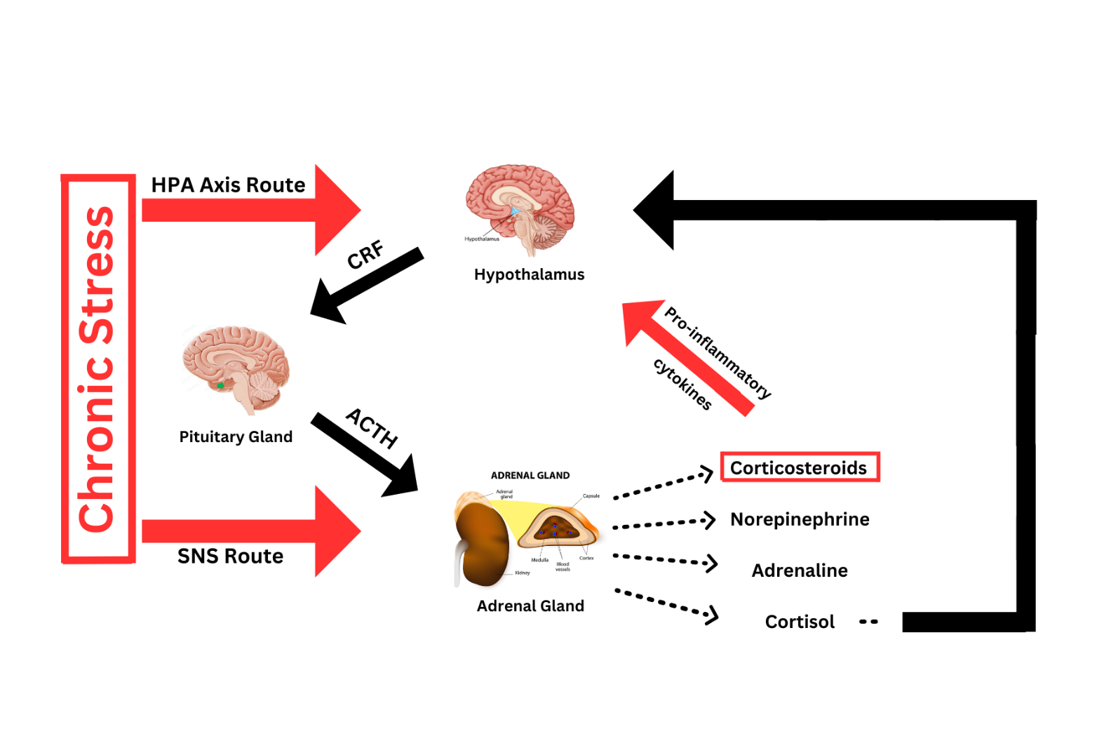
The Physiology of Stress
Step 1: Hypothalamus releases CRF at a higher-than-usual rate
Note: CRF = corticotropin-releasing factor

Slide 12
The Physiology of Stress
Step 2: Pituitary gland is hit with CRF, triggering it to release ACTH
Note: ACTH = adrenocorticotropic hormone

Slide 13
The Physiology of Stress
Step 3: Adrenal gland is triggered by both the HPA axis and the SNS, at the same time
Note: HPA axis = hypothalamic-pituitary-adrenal axis; SNS = sympathetic nervous system

Slide 14
The Physiology of Stress
Step 4: Adrenal gland releases a bunch of hormones

Slide 15
The Physiology of Stress
Step 5: In a healthy system, hormones like cortisol tell the hypothalamus to stop CRF production

Slide 16
The Physiology of Stress
Step 5b: In a chronically stressed system, hypothalamus desensitizes to cortisol, while corticosteroids mass produce pro-inflammatory cytokines (which can also activate hypothalamus)
Note: cytokines = potent signaling molecules; the immune system’s version of a hormone

Slide 17
The Physiology of Stress
Step 6: Hypothalamus never turns “off”, and continually releases CRF into bloodstream

Slide 18
STRESS & Illness

Slide 19
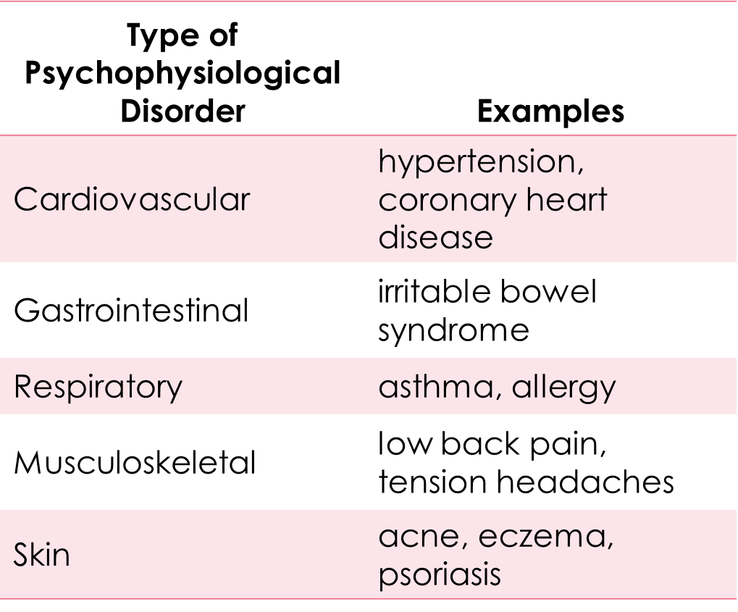
How Stress Impacts the Body

Slide 20
Stress and The Immune System
Immunosuppression
Autoimmune diseases
Psychoneuroimmunology
Lymphocytes
Lymphoma

Slide 21
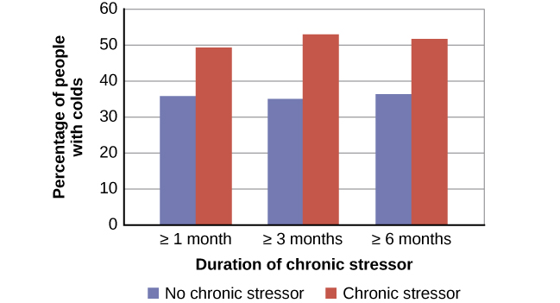
Stress and Common Colds

Slide 22
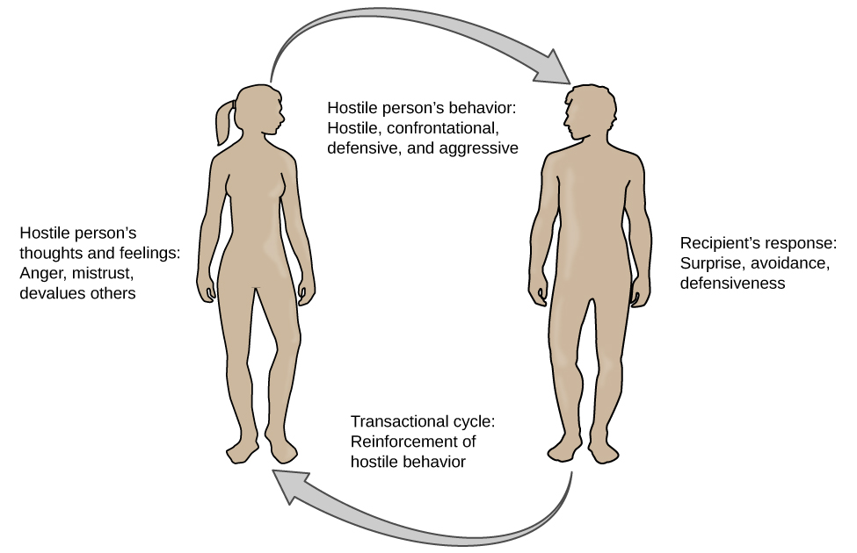
The Transactional Model of Hostility
Negative affectivity – is a tendency to experience distressed emotional states involving anger, contempt, disgust, guilt, fear, and nervousness

Slide 23
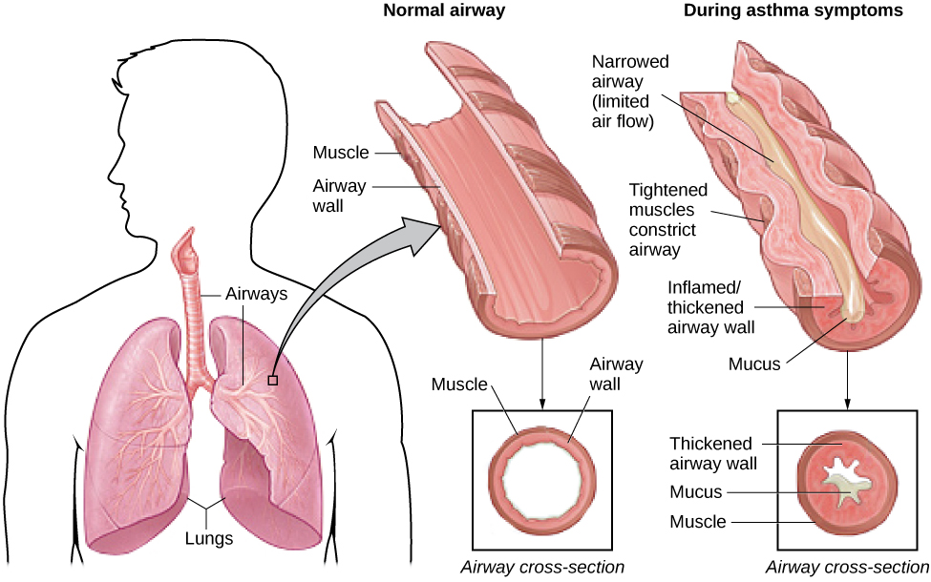
Asthma

Slide 24
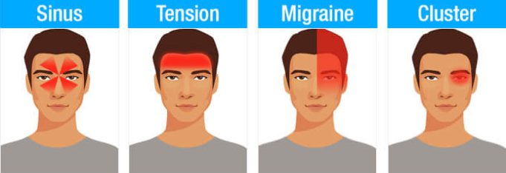
Headaches

Slide 25
The Regulation of STRESS

Slide 26
Coping Styles
Coping style – the approach a person typically utilizes when processing stress
How do you respond to a stressor?
Avoidance-oriented coping – a coping style where a person will push away stressor-related thoughts and feelings, deny the existence or seriousness of the stressor, or distract oneself
Approach-oriented coping – a coping style where a person makes an effort to solve the problem, seek support, and actively reframe the stressor towards the positive
Leads to better health outcomes
How do you cope with the stressor?
Problem-focused coping – attempting to do something constructive about the stressful conditions.
Emotion-focused coping – regulating emotions experienced because of the stressful event.

Slide 27
Handling Stress
Perceived control
Social support
Relaxation response techniques
Biofeedback

Slide 28
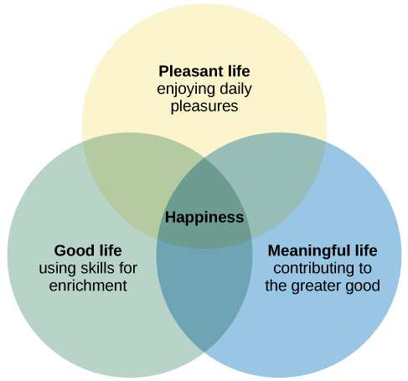
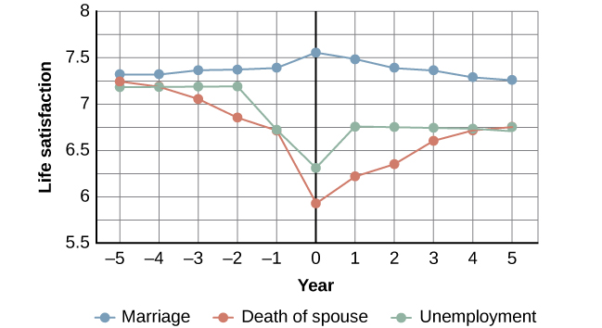
Positive Psychology: The Science of Happiness

Slide 29
Next time on PSY 203…
BEFORE NEXT CLASS:
NEXT CLASS:
Complete Exam 3 Reflection
Due tonight!
Read Chapter 15 & take quiz
Chapter 15 – Psychological Disorders

